Slide 1


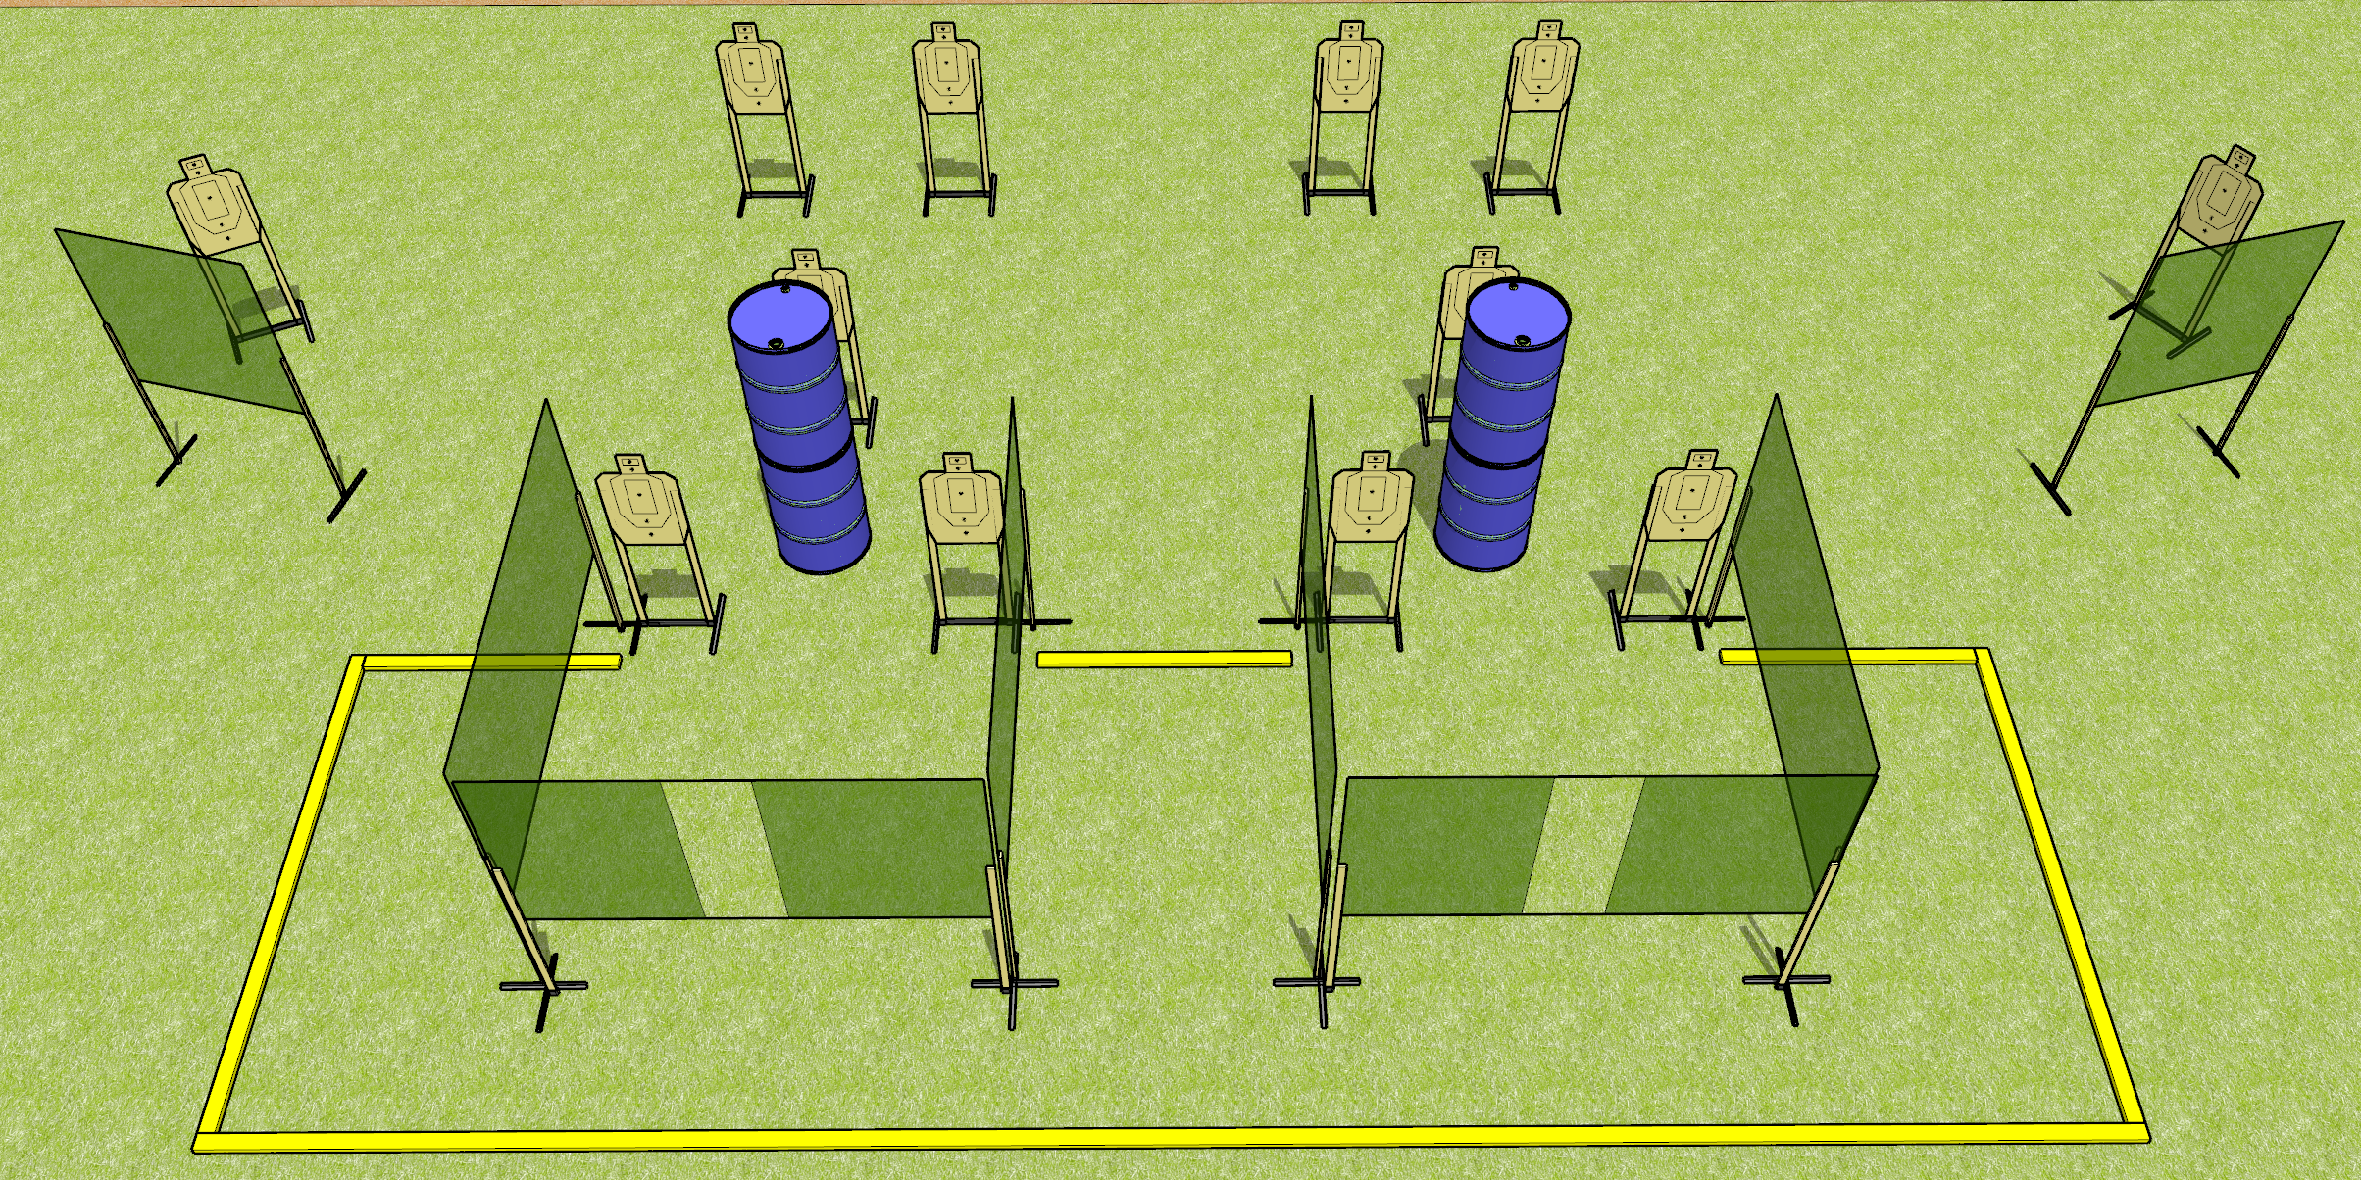
 | Dothan Gun Club – USPSA Match Just Open Targets Course Designer : Drew Coleman
Round Count 24 rounds 12 USPSA
Equipment List 3 medium fault lines 12 wall feet

Slide 2
Just Open Targets
Written Stage Briefing
Just Open Targets is a 24 round, 120 point, Comstock course of fire. There are 12 USPSA targets. The best 2 hits will score.
Handgun start position is anywhere inside the shooting area, wrists below belt. Handgun is loaded and holstered.
PCC start position is anywhere inside the shooting area, stock on belt. Loaded carbine is held with both hands, safety on.
On audible start signal, engage targets as they become available from within the shooting area.

